Slide 1
Geometry of single point cutting tool
Lecture 20

Slide 2
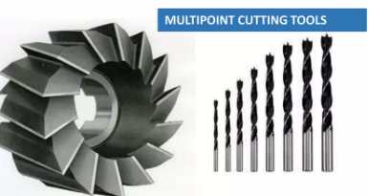
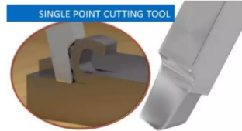
Types of Tool
Single-point cutting tool
  One cutting tip is available
  Low material removal rate
  e.g, lathe machine tools, shaping tools, planning tools
2. Multi-point cutting tool
  More than one tip is available
  High material removal rate
  e.g, milling cutter, grinding wheel, drill, etc.
Notes:
Engagement of entire blade into cutting need higher forces. Therefore, inclined blade is used to reduce force.

Slide 3
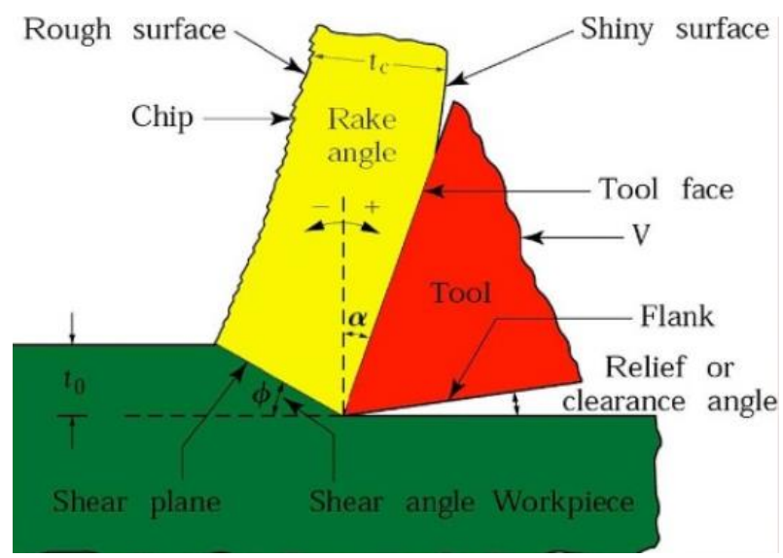
Elements of Metal Cutting
Tool and workpiece interaction, given a depth of cut and the relative motion between tool and the workpiece, results in chipping.
Cutting action involves shear deformation of the work material to form a chip, as the chip is removed, a new surface is exposed.
Notes:
Engagement of entire blade into cutting need higher forces. Therefore, inclined blade is used to reduce force.

Slide 4
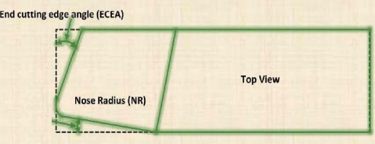
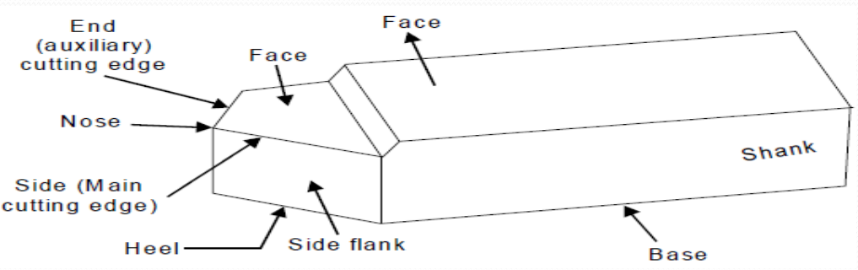
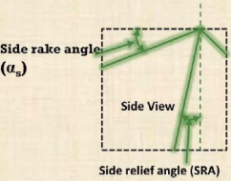
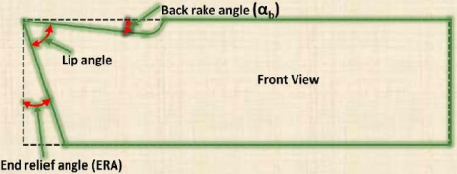
Tool Geometry
Notes:
Engagement of entire blade into cutting need higher forces. Therefore, inclined blade is used to reduce force.

Slide 5
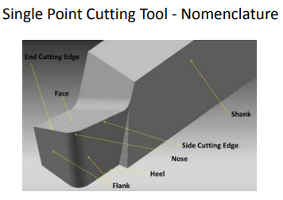
Tool Geometry
Notes:
Engagement of entire blade into cutting need higher forces. Therefore, inclined blade is used to reduce force.

Slide 6
Tool Geometry…
Side Cutting Edge Angle: The angle between the side cutting edge and the side of the tool shank is called the side cutting edge angle.
End Cutting Edge Angle: The angle between the end cutting edge and a line perpendicular to the shank of the tool is called the end cutting edge angle.
Side Relief Angle: The angle between the portion of the side flank immediately below the side cutting edge and a line perpendicular to the base of the tool.
Notes:
Engagement of entire blade into cutting need higher forces. Therefore, inclined blade is used to reduce force.

Slide 7
Tool Geometry…
4. End Relief Angle: The angle between the end flank and the line perpendicular to the base of the tool is called the end relief angle.
5. Back Rake Angle: The angle between the face of the tool and the line perpendicular to the base of the tool, measured on a perpendicular plane through the side cutting edge.
6. Side Rake Angle: The angle between the face of the tool and a line parallel to the base of the tool, measured on a plane perpendicular to the base and the side edge.
Notes:
Engagement of entire blade into cutting need higher forces. Therefore, inclined blade is used to reduce force.

Slide 8
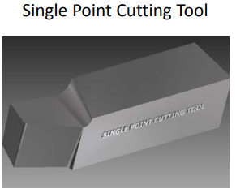
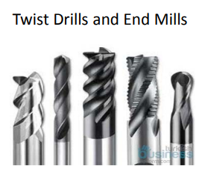
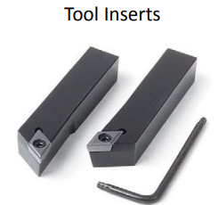
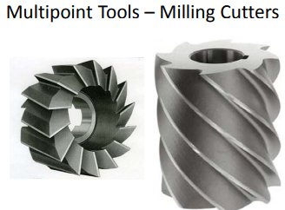
Tool Geometry…
Notes:
Engagement of entire blade into cutting need higher forces. Therefore, inclined blade is used to reduce force.

Slide 9
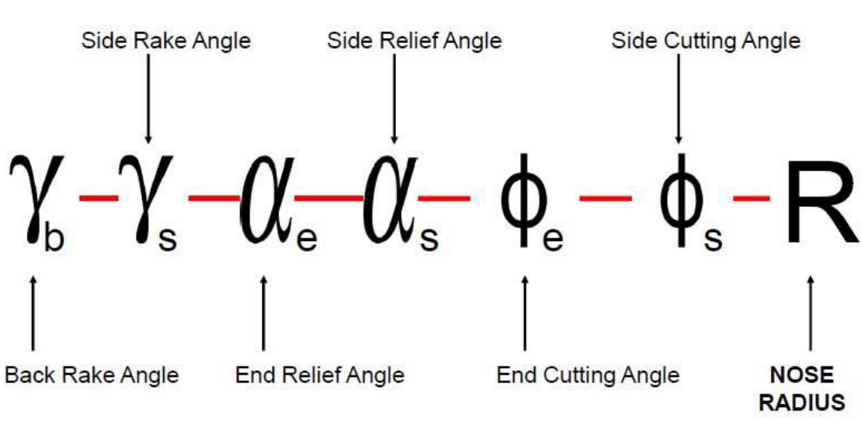
Signature
The shape of a tool is specified in a special sequence, and this special sequence is called the tool signature. The tool signature is given below
Back rake angle
Side rake angle
Clearance or End relief angle
Side relief angle
End cutting-edge angle
Side cutting edge angle
Nose radius
Notes:
Engagement of entire blade into cutting need higher forces. Therefore, inclined blade is used to reduce force.

Slide 10
Signature…
A typical tool signature of a single-point cutting tool is 0-7-6-8-15-16-0.8.
Here, this tool signature indicates that the tool has 0, 7, 6, 8,15, 16 degree back rake, side rake, end relief, side relief, end cutting edge, side cutting edge angle, and 0.8 mm nose radius.
Notes:
Engagement of entire blade into cutting need higher forces. Therefore, inclined blade is used to reduce force.

Slide 11
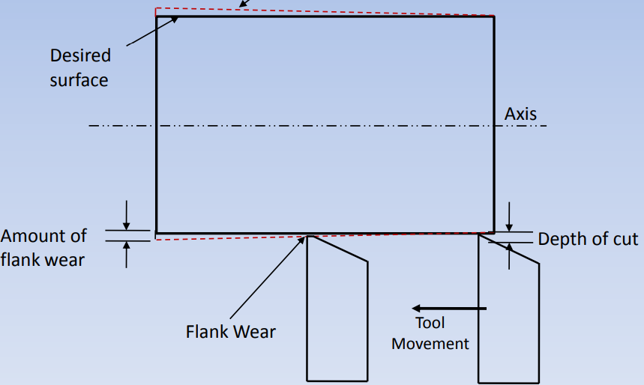
Effect of tool wear on machined surface
FLANK WEAR AFFECTS:
Dimensional accuracy
Process stability
Surface finish

Slide 12
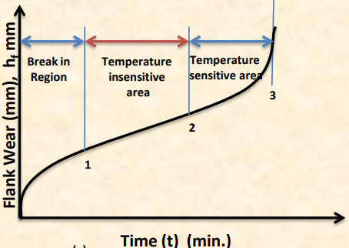
Three stages of flank wear:
1. Rapid growth region (Break in region)
2. Steady state region (Temperature Insensitive region)
3. Catastrophe failure (Temperature-sensitive region)
Flank wear formation depends on
* Cutting Conditions (f, d, V, tool angles) [f: feed, d: depth of cut]
* Properties of work material and tool material

Slide 13
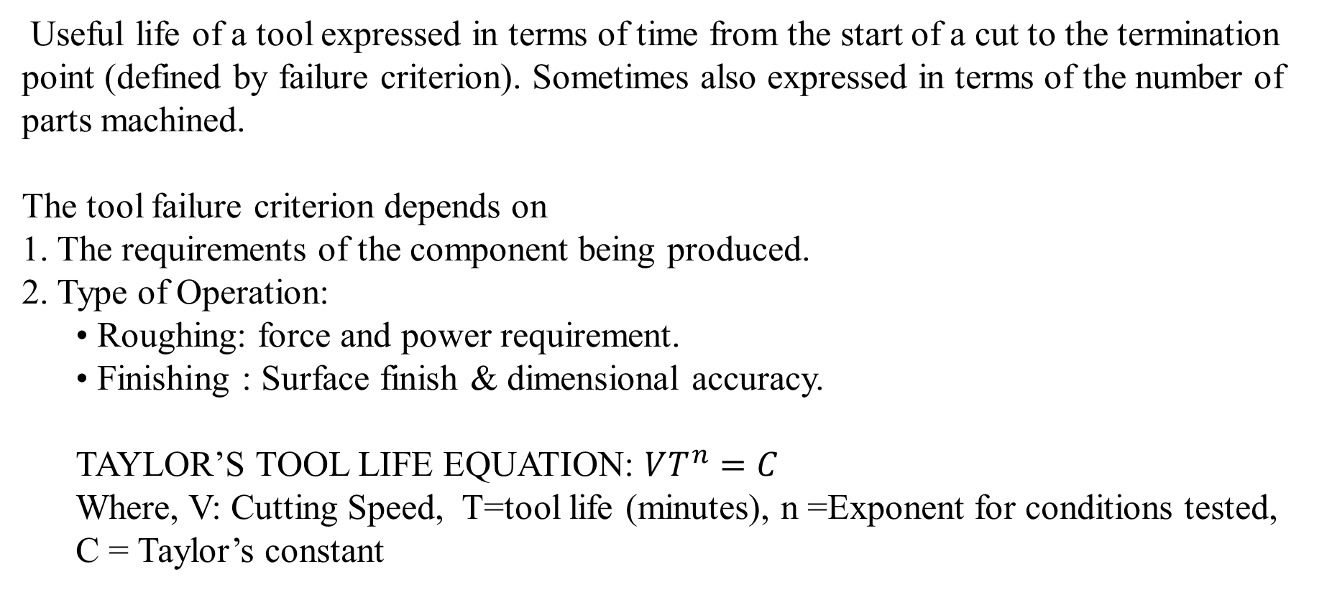
TOOL LIFE
Useful life of a tool expressed in terms of time from the start of a cut to the termination point (defined by failure criterion). Sometimes also expressed in terms of the number of parts machined.
The tool failure criterion depends on
1. The requirements of the component being produced.
2. Type of Operation:
  • Roughing: force and power requirement.
  • Finishing : Surface finish & dimensional accuracy.
  TAYLOR’S TOOL LIFE EQUATION: $VT^{n}=C$
  Where, V: Cutting Speed, T=tool life (minutes), n =Exponent for conditions tested,
  C = Taylor’s constant

Slide 14
VARIABLES AFFECTING TOOL LIFE
• Cutting Conditions (V, d, f)
• Tool Geometry (all six angles, and nose radius)
• Workpiece Material
• Cutting fluid
• Machine tool and Workpiece region
• Tool Material

